Slide 1
Twist Challenge
Nmeso Egwuekwe

Slide 2
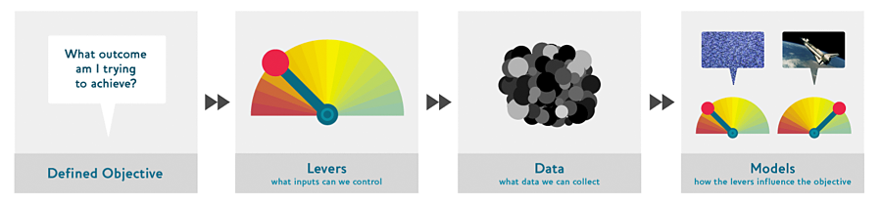

Slide 3
Problem:
Imagine an app (Integrated food delivery app) that different restaurants use as a platform for customers to buy and deliver food. Imagine having to type a particular type of food and having image results of the food types and direct links to the restaurant. This would save the time of going through each restaurant to find a particular type of food and also allow you to explore similar food types based on the image

Slide 4
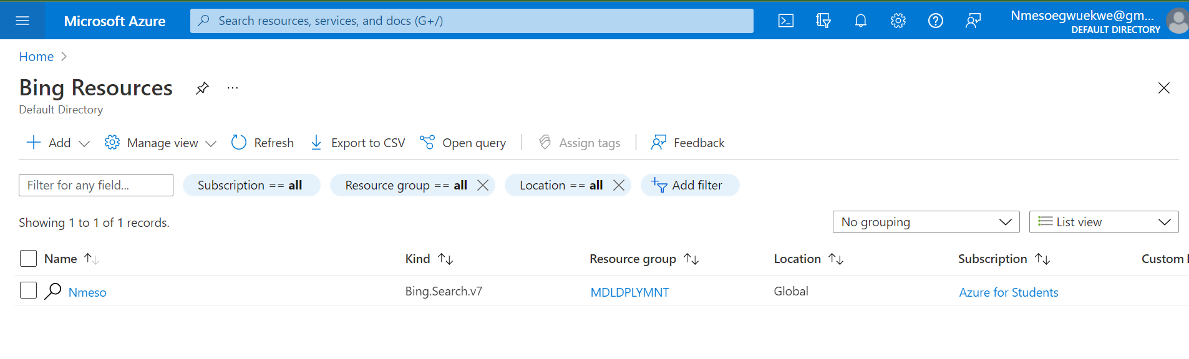
Training Data:
The Images are scraped using the Microsoft Azure Bing Image search API

Slide 5

Pretrained Model:
Models used to test best performance on validation data are
ResNet18
ResNet50

Slide 6
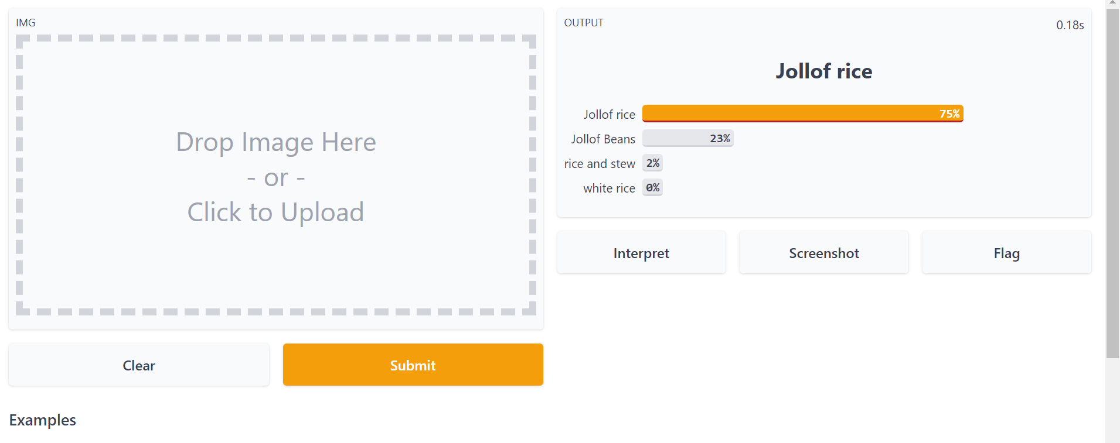
GUI:
Gradio.io

Slide 7
Data Augmentation

Slide 8
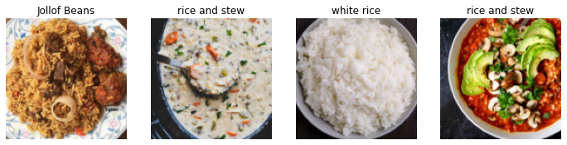
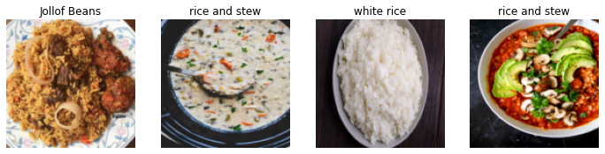
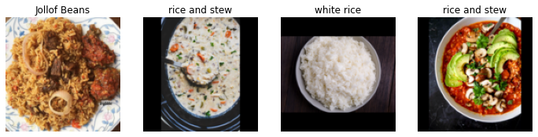
ORIGINAL
Resize method (squish)
Resize method (Pad)

Slide 9
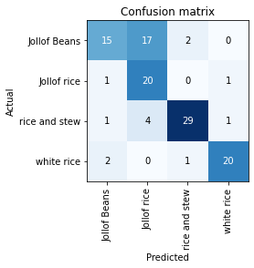
Training outcomes
Resnet 18

Slide 10
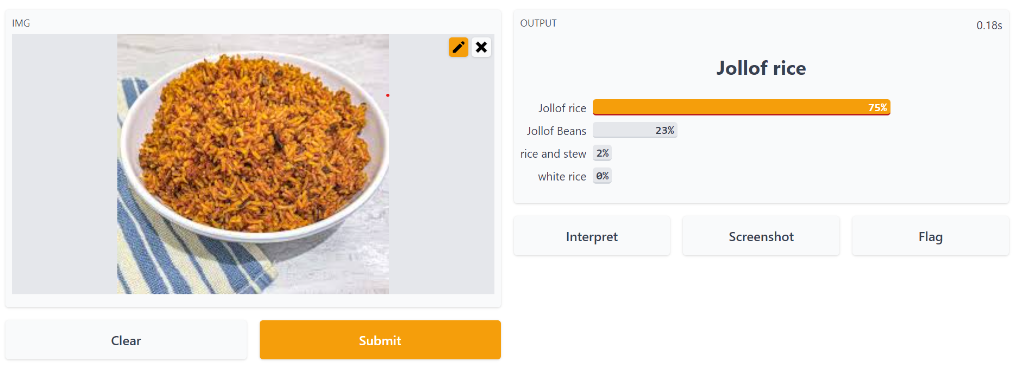
Gradio Link: https://47987.gradio.app/

Slide 11
Challenges
Images with both rice and beans but having either as label. How to separate that
Resnet 50 model crashing

